Slide 1
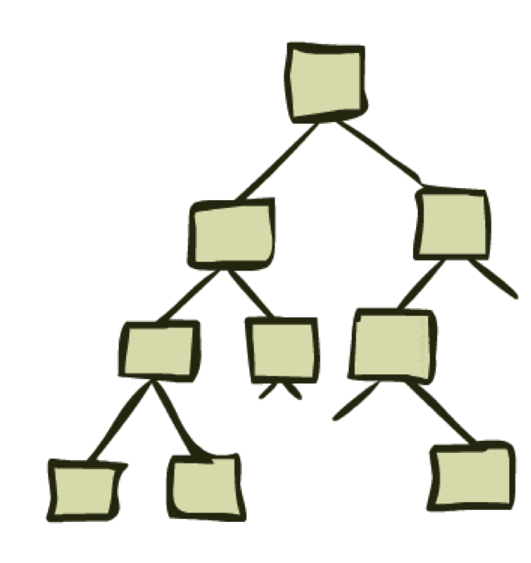
Uninformed Search-II
Depth First Search and its Variants

Slide 2
Depth-Limited Search (DLS)
DFS with a depth bound
  Searching is not permitted beyond the depth bound.
Works well if we know what is the depth of the solution.
If the solution is beneath the depth bound, the search cannot find the goal (hence this search algorithm is incomplete).

Slide 3
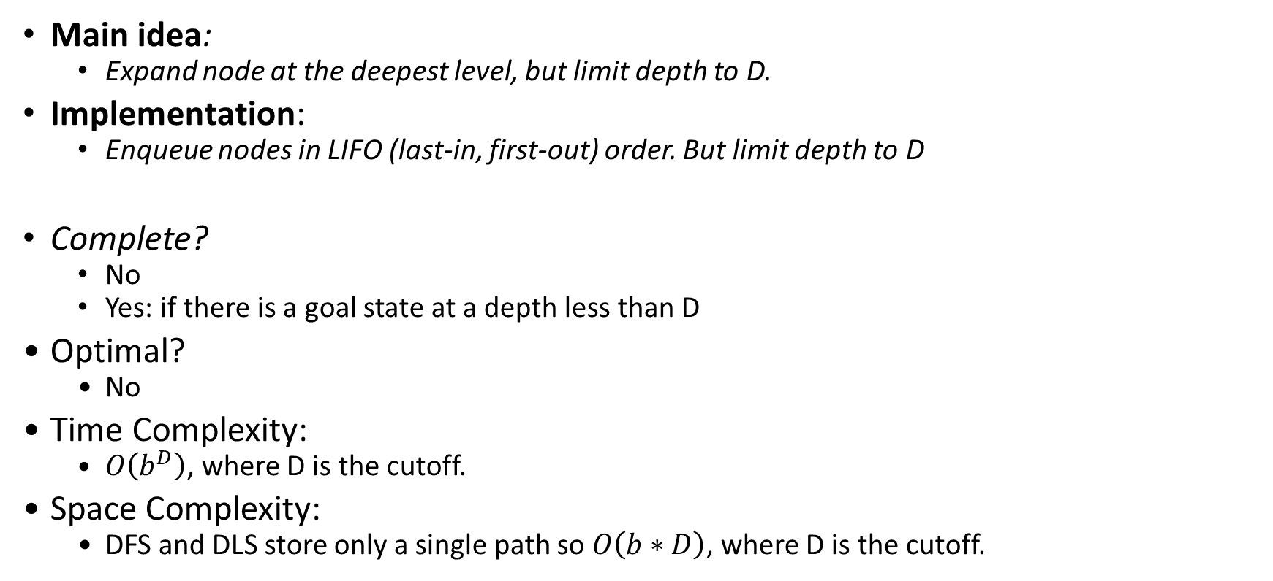
Depth-Limited Search (DLS)
Main idea:
  Expand node at the deepest level, but limit depth to D.
Implementation:
  Enqueue nodes in LIFO (last-in, first-out) order. But limit depth to D
Complete?
  No
  Yes: if there is a goal state at a depth less than D
Optimal?
  No
Time Complexity:
  $O\left(b^{D}\right)$, where D is the cutoff.
Space Complexity:
  DFS and DLS store only a single path so $O\left(b∗D\right)$, where D is the cutoff.

Slide 4
Iterative Deepening Search
To avoid the infinite depth problem of DFS:
  Only search until depth L
  i.e, don’t expand nodes beyond depth L
  Depth-Limited Search
What if solution is deeper than L?
  Increase depth iteratively
  Iterative Deepening Search (IDS)
IDS
  Inherits the memory advantage of depth-first search
  Has the completeness property of breadth-first search

Slide 5
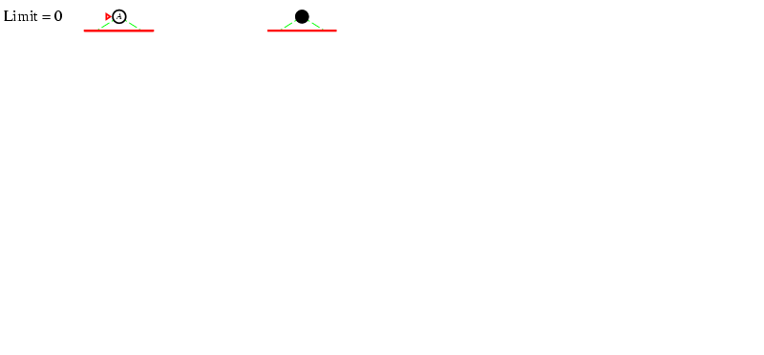
Iterative deepening search l =0
5

Slide 6
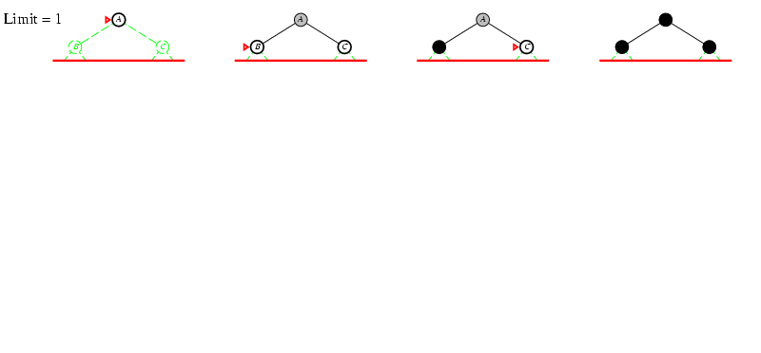
Iterative deepening search l =1
6

Slide 7
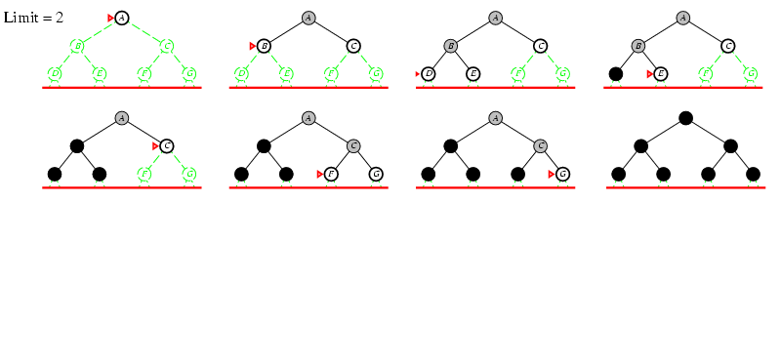
Iterative deepening search l =2
7

Slide 8
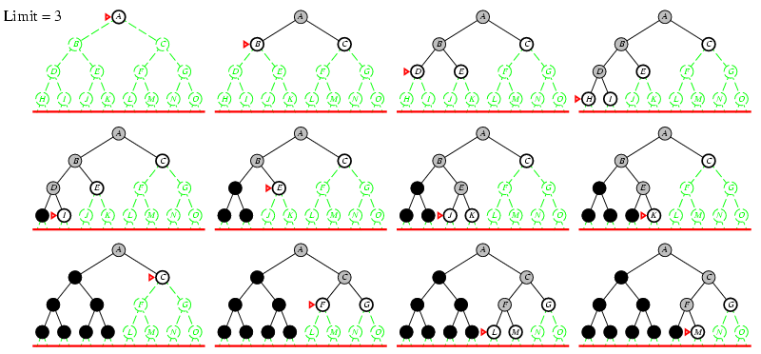
Iterative deepening search l =3
8

Slide 9
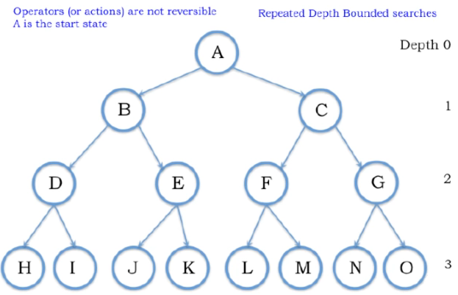

Slide 10
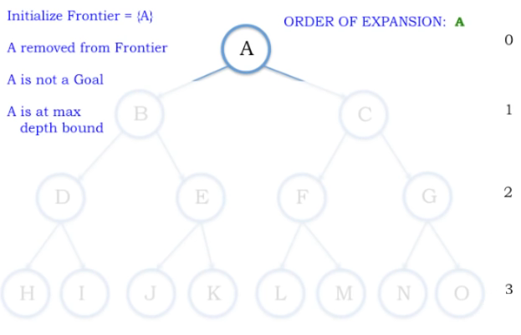
Depth Bound = 0

Slide 11
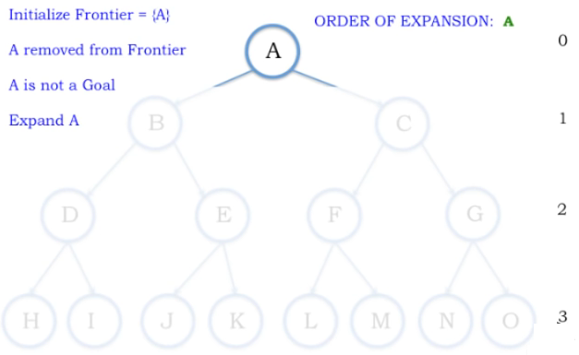
Depth Bound = 1

Slide 12
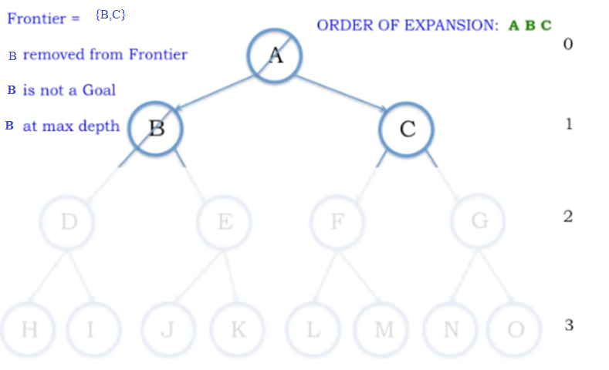
Depth Bound = 1

Slide 13
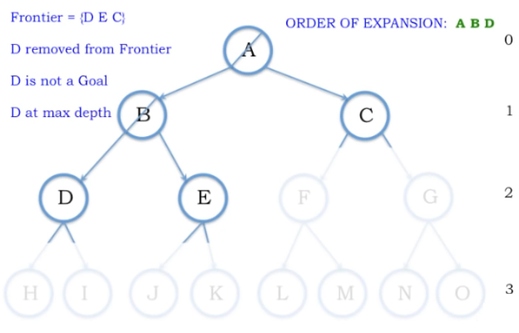

Slide 14
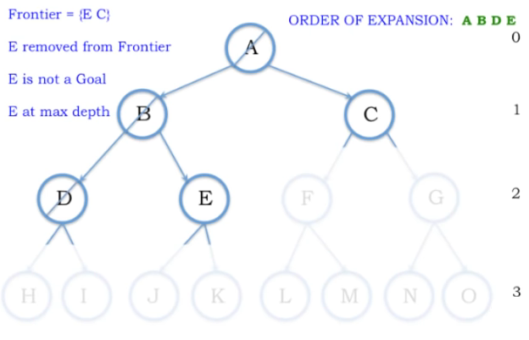

Slide 15
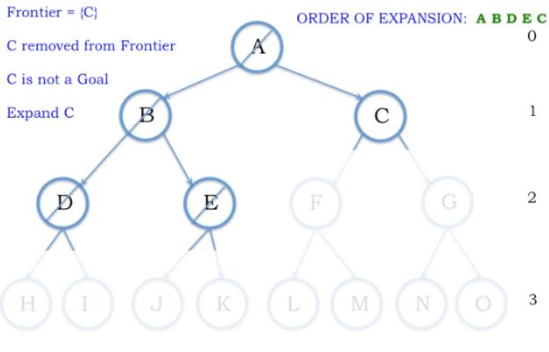

Slide 16
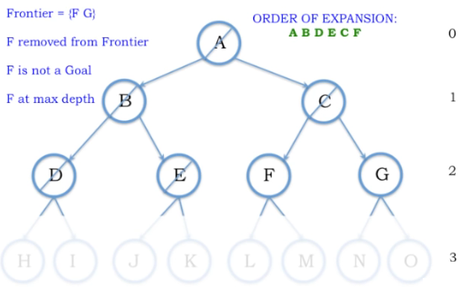

Slide 17
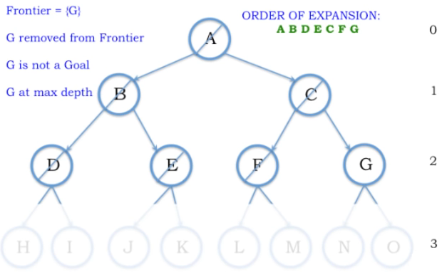
Depth 2

Slide 18
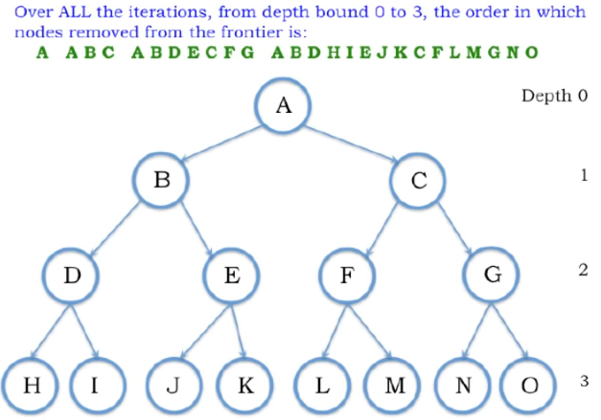

Slide 19
Properties of Iterative Deepening Search
Complete? Yes (even in infinite or cyclic state spaces, because of depth limit reset)
Time? O(b^{d})
Space? O(bd)
Optimal? Yes, (if step cost = 1 i.e. identical step cost)
19

Slide 20
Activity
A
D
B
Do it on notebook
Start Node: A
Goal Node: G
Step Frontier Expand[*] Explored: a set of nodes
F
E
C
G
B
G
E

Slide 21
Cost-Sensitive Search
a
GOAL
2
2
b
c
3
2
1
8
2
e
d
f
3
9
8
2
START
h
1
4
2
p
4
r
15
q
BFS finds the shortest path in terms of number of actions.
It does not find the least-cost path. We will now cover
a similar algorithm which does find the least-cost path.

Slide 22
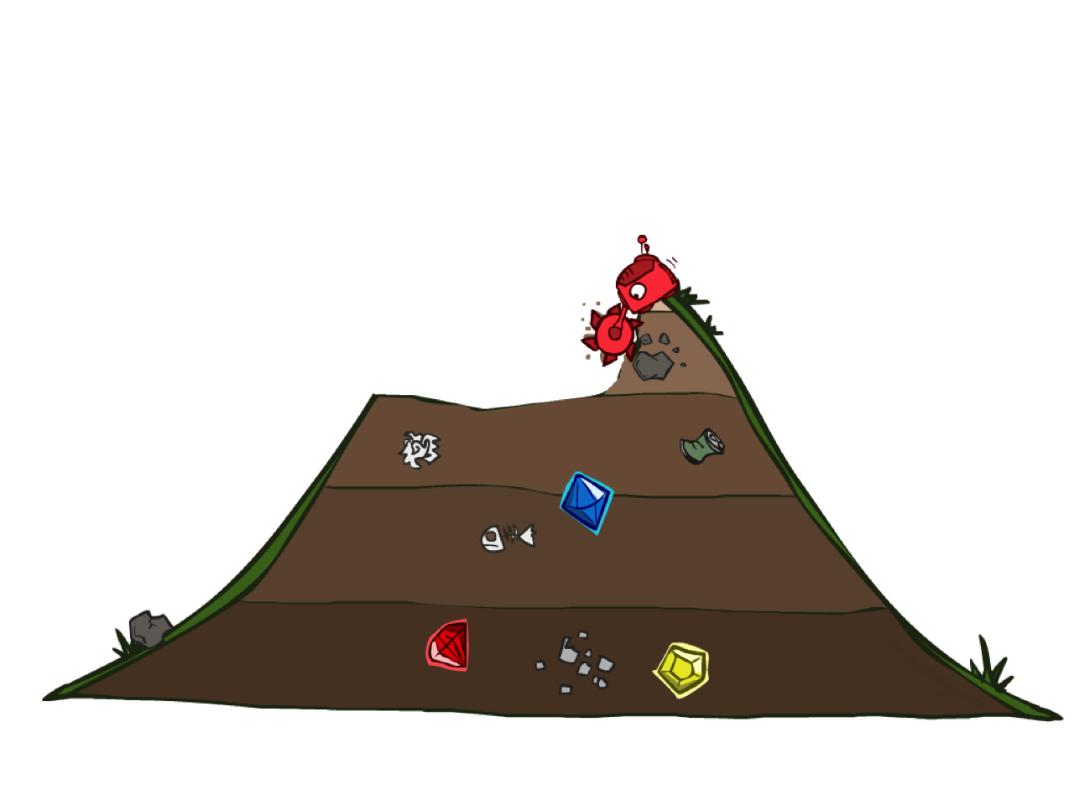
Uniform Cost Search
Notes:
Why Uniform Cost name because always expand nodes in order of cost

Slide 23
Uniform Cost Search
Breadth-First Search find the shallowest goal state, but this may not always be the least-cost solution.
Uniform-Cost Search modifies the Breadth-First Search strategy by always expanding the lowest path cost g(n) node on the fringe (outlier).
Frontier is a priority queue, i.e., new successors are merged into the queue sorted by g(n).
  Can remove successors already on queue w/higher g(n).
  Saves memory, costs time; another space-time trade-off.

Slide 24
Uniform Cost Search
2
G
a
Strategy: expand a cheapest node first:
Fringe is a priority queue (priority: cumulative cost)
b
c
1
8
2
2
e
3
d
f
9
8
2
S
h
1
1
p
q
r
15
0
S
d
3
e
9
p
1
b
4
e
5
h
17
r
11
q
16
c
11
Cost contours
a
6
a
h
13
r
7
p
q
f
p
q
f
8
q
c
G
q
c
a
11
G
10
a
Notes:
Like breadth first, but with costs. Label with cumulative cost.
Goal path not victory until try to expanded.
Contours show equal cost.

Slide 25
Uniform Cost Search (UCS)
A
5
2
[5]
B
C
[2]
1
4
1
7
D
[6]
[3]
F
G
[9]
[9]
E
Goal state
4
5
[x] = g(n)
path cost of node n
[7]
H
I
[8]

Slide 26
Uniform Cost Search (UCS)
A
5
2
[5]
B
C
[2]

Slide 27
Uniform Cost Search (UCS)
A
5
2
[5]
B
C
[2]
1
7
[3]
F
G
[9]

Slide 28
Uniform Cost Search (UCS)
A
5
2
[5]
B
C
[2]
1
7
[3]
F
G
[9]
4
5
[7]
H
I
[8]

Slide 29
Uniform Cost Search (UCS)
A
5
2
5
2
[2]
[5]
B
C
[2]
[5]
1
4
1
1
7
7
D
[6]
[3]
F
G
[9]
[3]
[9]
[9]
E
4
5
4
5
[7]
H
I
[8]
[7]
[8]

Slide 30
Uniform Cost Search (UCS)
A
5
2
5
5
2
2
[2]
[2]
[5]
B
C
[2]
[5]
[5]
Goal state path cost g(n)=[6]
1
1
4
1
4
1
1
7
7
7
D
[3]
F
G
[9]
[3]
[3]
[9]
[9]
[9]
[9]
E
4
5
4
4
5
5
[7]
H
I
[8]
[7]
[7]
[8]
[8]

Slide 31
Uniform Cost Search (UCS)
A
5
2
5
5
2
2
[2]
[2]
[5]
B
C
[2]
[5]
[5]
1
1
4
1
4
1
1
7
7
7
D
[6]
[3]
F
G
[9]
[6]
[3]
[3]
[9]
[9]
[9]
[9]
E
4
5
4
4
5
5
[7]
H
I
[8]
[7]
[7]
[8]
[8]

Slide 32
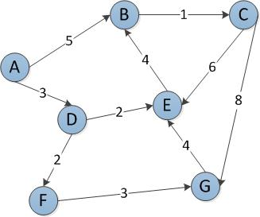
Start Node: A
Goal Node: G
Step Frontier Expand[*] Explored: a set of nodes
1 {(A,0)} A ∅
2 {(A-D,3),(A-B,5)} D {A}
3 {(A-B,5),(A-D-E,5),(A-D-F,5)} B {A,D}
4 {(A-D-E,5),(A-D-F,5),(A-B-C,6)} E {A,D,B}
5 {(A-D-F,5),(A-B-C,6),(A-D-E-B,9)*} F {A,D,B,E}
6 {(A-B-C,6),(A-D-F-G,8) C {A,D,B,E,F}
7 (A-D-F-G,8),(A-B-C-G,14) G {A,D,B,E,F,C}
8 ∅
Found the path: A -> D -> F -> G.
*B is not added to the frontier because it is found in the explored set.

Slide 33
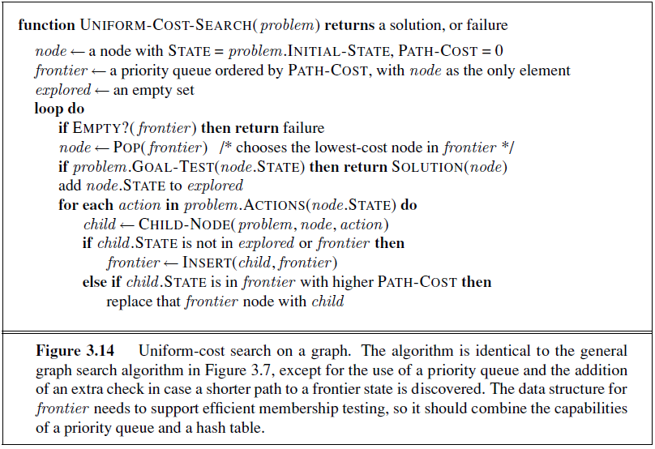
Uniform Cost Search

Slide 34
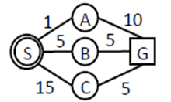
Uniform Cost Search

Slide 35
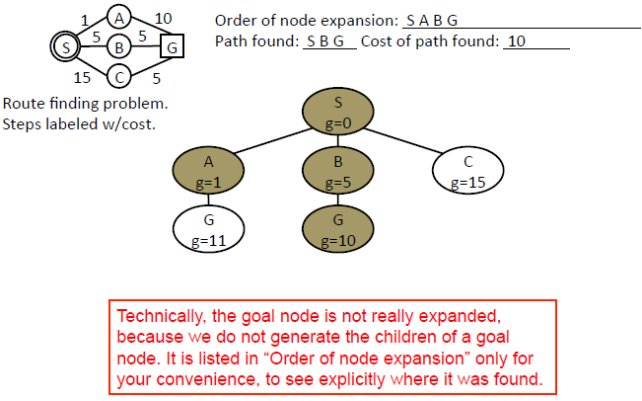
Uniform Cost Search

Slide 36
Uniform Cost Search (UCS) Properties
What nodes does UCS expand?
  Processes all nodes with cost less than cheapest solution!
  If that solution costs C* and arcs cost at least ε , then the “effective depth” is roughly C*/ε
  Takes time O(b^{C*/ε}) (exponential in effective depth)
How much space does the fringe take?
  Has roughly the last tier, so O(b^{C*/ε})
Is it complete?
  Assuming best solution has a finite cost and minimum arc cost is positive, yes!
Is it optimal?
  Yes! (Proof next lecture via A*)
b
c ≤ 1
…
C*/ε “tiers”
c ≤ 2
c ≤ 3

Slide 37
Uniform Cost Issues
…
c ≤ 1
Remember: UCS explores increasing cost contours
The good: UCS is complete and optimal!
The bad:
  Explores options in every “direction”
  No information about goal location
We’ll fix that soon!
c ≤ 2
c ≤ 3
Start
Goal

Slide 38
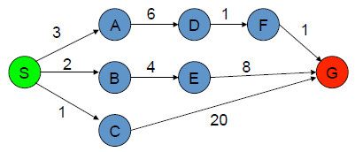
Uniform Cost Search (Activity 1)
The graph above shows the step-costs for different paths going from the start (S) to the goal (G).
Use uniform cost search to find the optimal path to the goal.
Step | Frontier | Expand | Explored
1
2

Slide 39
 | Frontier | Expand | Explored
1 | S | S | Empty
2 | (S-C,1) (S-B,2)(S-A,3) | C | S
3 | (S-B,2)(S-A,3)(S-C-G,21) | B | S,C
4 | (S-A,3)(S-C-G,21)(S-B-E,6) | A | S,C,B
5 | (S-C-G,21)(S-B-E,6)(S-A-D,9) | E | S,C,B,A
6 | (S-C-G,21) (S-A-D,9) (S-B-E-G,14) | D | S,C,B,A,E
7 | (S-C-G,21) (S-B-E-G,14) (S-A-D-F,10) | F | S,C,B,A,E,D
8 | (S-C-G,21) (S-B-E-G,14) (S-A-D-F-G,11) | G
9 | S-A-D-F-G,11 Goal Found |  | S,C,B,A,E,D,F,G

Slide 40
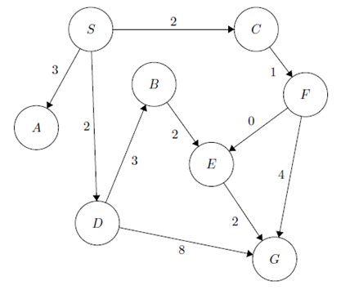
Activity 2
Step | Frontier | Expand | Explored: a set of Nodes
1 | (S,0) | S | Ø
2 | (S-C,2) (S-D,2) (S-A,3) | C | S
3 | (S-D,2) (S-A,3)(S-C-F,3) | D | S,C
4 | (S-A,3)(S-C-F,3)(S-D-B,5)(S-D-G,10) | A | S,C,D
5 | (S-C-F,3)(S-D-B,5)(S-D-G,10) | F | S,C,D,A
6 | (S-D-B,5)(S-D-G,10)(S-C-F-E,3)(S-C-F-G,7) | E | S,C,D,A,F
7 | (S-D-B,5)(S-D-G,10) (S-C-F-G,7) (S-C-F-E-G,5) | B | S,C,D,A,F,E
8 | (S-D-G,10) (S-C-F-G,7) (S-C-F-E-G,5)(S-D-B-E,7)already visited | G | S,C,D,A,F,E,B
9 | (S-C-F-E-G,5) Goal Found

Slide 41
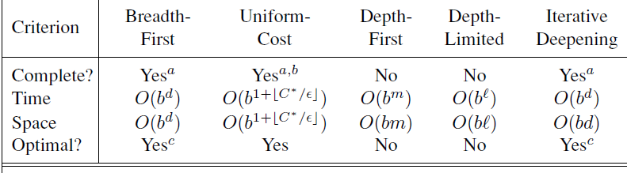
Summary of Algorithms
b branching factor
d depth of the shallowest solution
m maximum depth of the search tree
l depth limit
Superscripts:
a complete if b is finite
b complete if step costs ≥ epsilon for +ve epsilon
c optimal if step costs are all identical
41

Slide 42
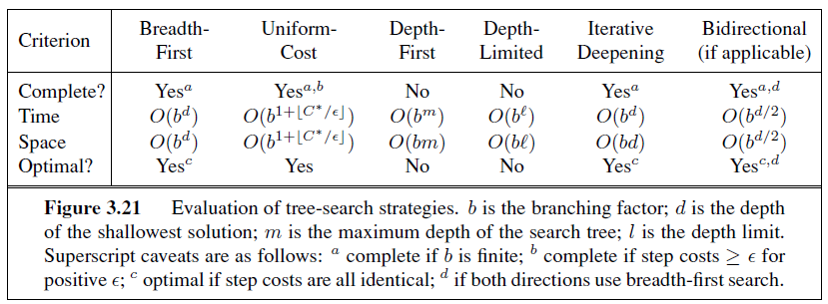
Summary of Algorithms

